Slide 1

Coupon Setup System
Yash Ghia

Slide 2
CONTENTS
Introduction
Business Objectives
Scope of CSU
High Level Functionality
CSU Interface
CSU Architecture
Technical details
Appendix

Slide 3
INTRODUCTION
The Coupon Setup System covers the activities that are involved in:
Defining new coupons and vouchers that will be made available to customers.
Maintaining existing coupons and vouchers when amendments are required,
Communication of information about coupons and vouchers to all systems that require access to this information. E.g. store systems.

Slide 4
BUSINESS OBJECTIVES
  Providing platform for defining all coupons and vouchers according to the business requirement.
  Providing coupons and vouchers information to the store till systems.
  Support for all stages of the project through to the end of integration testing.
  Recording information for financial and related supplier recharge activities.

Slide 5
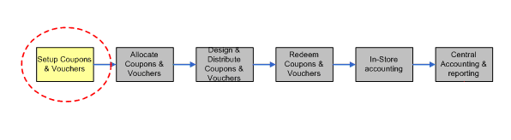
SCOPE OF CSU
The scope of CSU is limited to setting up 13 digit EAN numbers for vouchers & coupons and exporting them to Storeline for redemption of vouchers and coupons.

Slide 6
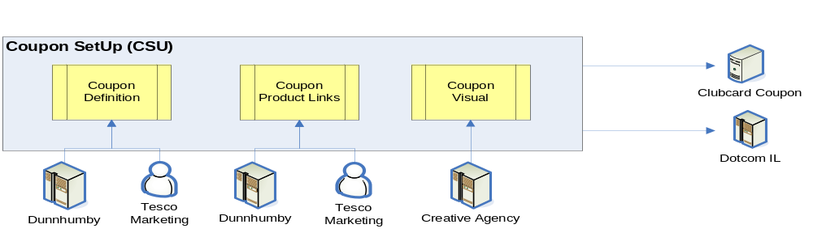
HIGH LEVEL FUNCTIONALITY
The overall high level functionality of the system is broken down into three major areas:
Coupons – The ability to manage and define coupons & vouchers
System – Automatic system tasks performed by the system. E.g. loading product information.
Administration – Background activities required to allow the system to function. This will be a business role.

Slide 7
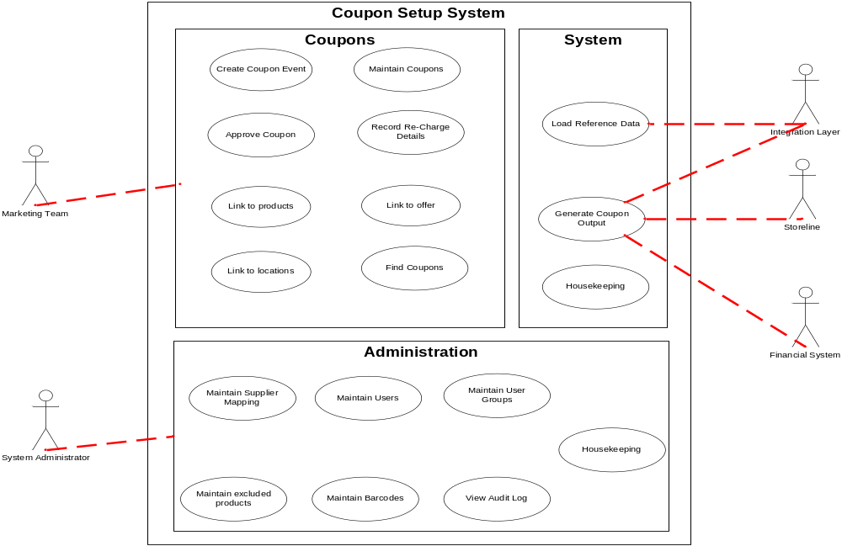
FUNCTIONALITY

Slide 8
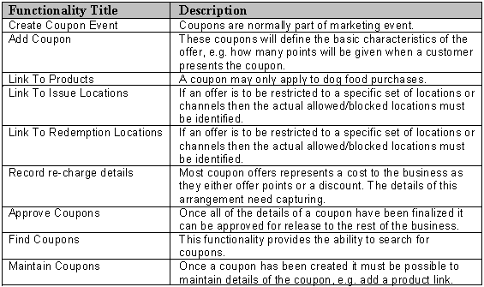
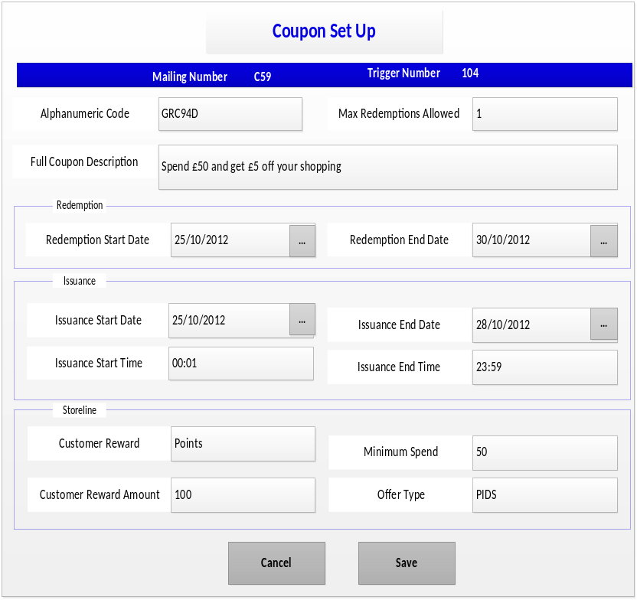
1. Coupons

Slide 9
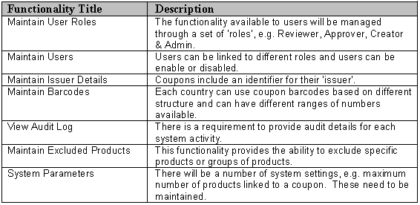
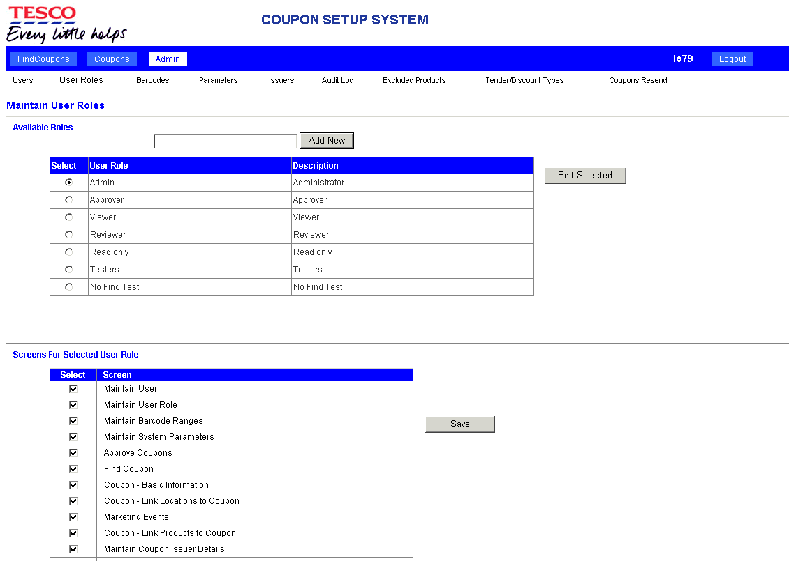
2. Administrator

Slide 10
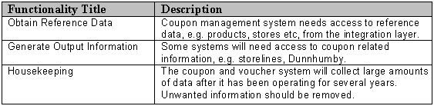
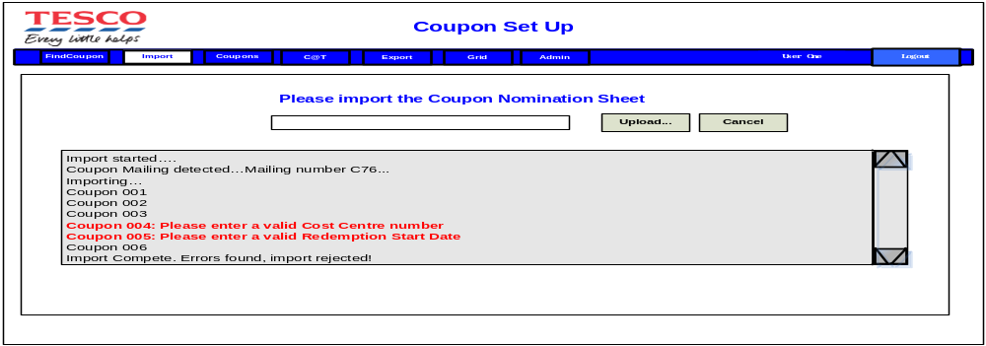
3. System
3.1 Import

Slide 11
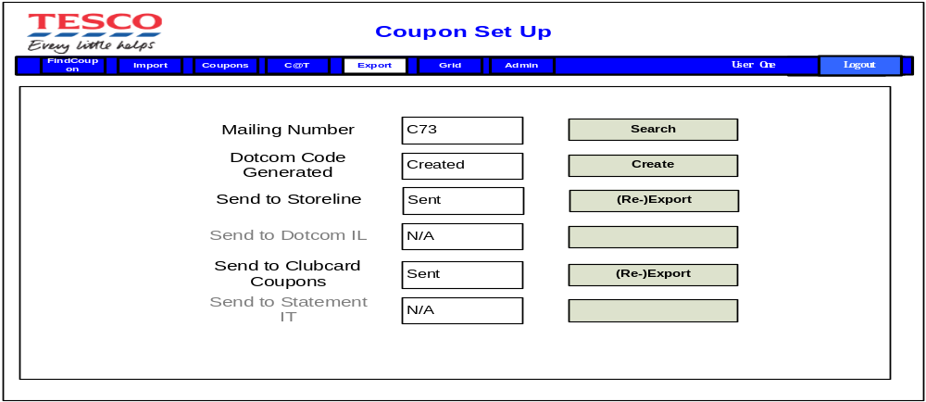
3.2 Export

Slide 12
Coupons generated using CSU follows 2 Channels:
A) Issuance channel
STATEMENT/LCM - Mailing
TILL - Storeline
WEB - (TESCO pays the difference is cost of the product.)
B) Redemption channel
STORE - Store barcode
GHS (online) - Dotcom barcode + alphacode
Other - Not in scope

Slide 13
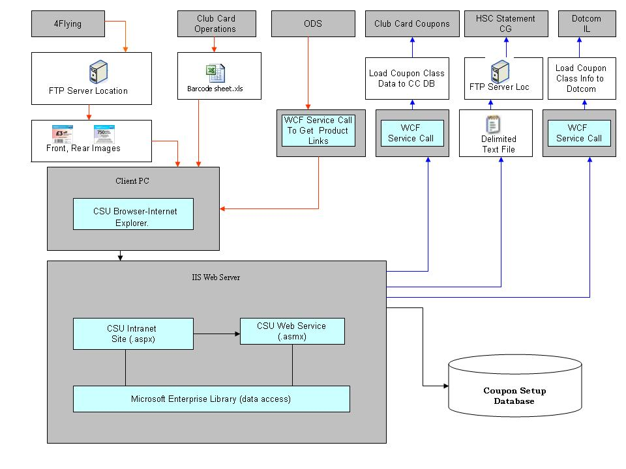
CSU INTERFACE

Slide 14
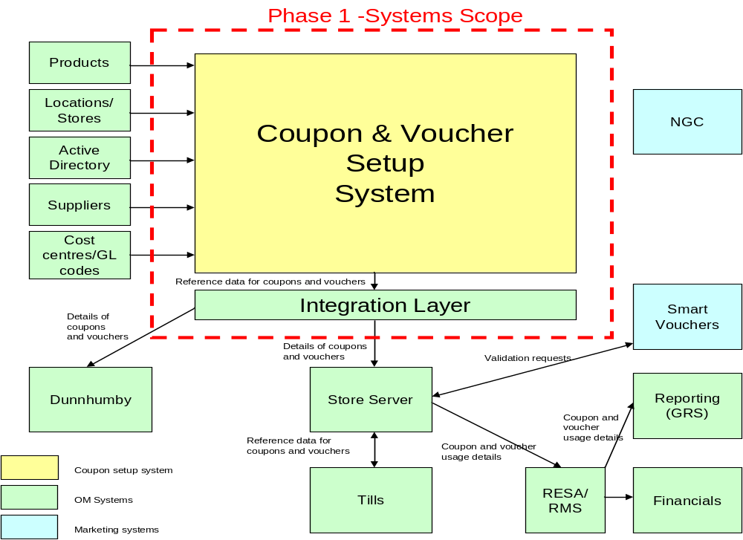
CSU ARCHITECTURE

Slide 15
TECHNICAL DETAILS
When the coupon nominations have been approved and signed-off, the Statement Coupon, Loyalty Coupon Mailing or Coupon At Till coupon information will be imported into CSU through the barcode sheet.
All the required barcodes and alphanumeric codes will be generated. Any artwork will be imported and then the approved coupons can be transmitted to
Storeline for customer redemption,
Exported to dotcom systems for GHS redemption.
Forwarded to the Clubcard Coupons systems to have the class coupons converted into unique customer-issued Smart coupon instances.
For Coupon At Till there will be an additional, Group-only stage where the coupon wording and formatting will be captured.

Slide 16

APPENDIX
Hub Link:
http://team.hub.tesco.org/HeadOfficeandCommercialIT/clubcardmarketingIT/Coupons_Vouchers/Coupon%20Setup/Forms/AllItems.aspx

Slide 17
THANK YOU

